Slide 1
THREAT ALERT AI
TEAM MEMBERS
SAI SHANKAR 2010030054
PS YESHWANTH 2010030122
SRIKAR KANCHE 2010030474
SAI MANASWI 2010030325
Mentor: Dr. Rama Rao

Slide 2

TABLE OF CONTENTS
PROJECT AREA
PROBLEM STATEMENT
SCENARIO
LITERATURE SURVEY
GOALS
TOOLS
APPROACH
DATASETS
REFERENCES

Slide 3

PROJECT AREA
The idea of Threat Alert AI comes under the domain of Speech recognition and the sub-domain of SPEECH_TO_TEXT in Artificial Intelligence.
Speech Recognition is the artificial production of human speech.
A computer system used for this purpose is called a speech computer or speech recognizer and can be implemented in software or hardware products.

Slide 4



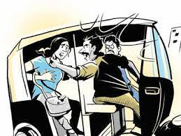
PROBLEM STATEMENT
A safety application that listens when the app is on. If it hears keywords like “bachaav or help”
The Artificial intelligence models need to judge the tone or emotional state of the statement and automatically trigger some actions like sending texts to nearby police station, she teams etc.

Slide 5

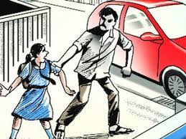
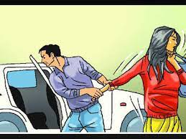


SCENARIO
The school girl being kidnapped near her house shouting for help.
The woman being kidnapped into car shouting for help.
The woman being kidnapped in an auto shouting for help.

Slide 6
Literature Survey
S.No | Author | Journal | Algorithms / Techniques | Accuracy | Scope
1. | N. Bhardwaj N. Aggarwal | International Journal of Information & Computation Technology | Voice/Speech Recognition System Training Words for Recognition | 80% | Measure Heart Rate
2. | D. G. Monisha1 M. Monisha G. Pavithra R. Subhashini | Indian Journal of Science and Technology | Using ARM controller for the hardware device is the most efficient and it consumes less power. We use radio frequency signal detector to detect hidden cameras | 80% | Emergency Button

Slide 7
Literature Survey
S.No | Author | Journal | Algorithms | Accuracy | Scope
3. | B. Pawar, H. Kulabkar S. Pawar R. Tambe | International Research Journal of Engineering and Technology | Detecting the heartbeat The GPS and GSM are integrated with the device used to send an alert notification to the emergency contacts. | 70% | Speech recognition
4. | Akram, Wasim, Mohit Jain, and C. Sweetlin Hemalatha. | Science Direct | Sending group messages from the device as well as from the victims’ phone. Recording audio of the victim which may be later used as proof against the perpetrator. Locating safe place from victim’s current location on the map | 75% | Live location sharing

Slide 8
Goals
While a woman is in a help situation, using the mobile microphone, this application should recognize the "Help" word and activate the application.
Recognize fear tone of the woman.
Send alert to Police through mail.

Slide 9
Tools
Predefined Modules
Speech Recognition
PyAudio
Librosa
smptlib
Frame Works
Kivy
Software
Pycharm

Slide 10

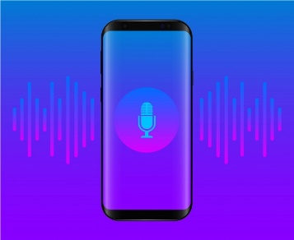
Approach
INITIAL PHASE :
While a woman is in a help situation, she shouts for help,
Step 1: Speech Recognition library recognizes the audio of women
through mobile microphone.
step 2: pyttsx3 library converts audio to text .
step 3: if the recognized text is Help or Bachaav or Rakshinchandi,
then the application will active.

Slide 11
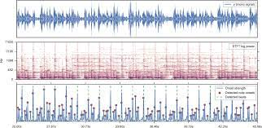
Approach
PROCESS PHASE :
Librosa is a Python package for audio analysis.
Step 1: Librosa analyses the fear tone of the woman so that fault detection will be done.
step 2: Once Librosa detects fear tone, the application fetches the
location of the woman using mobile GPS .

Slide 12
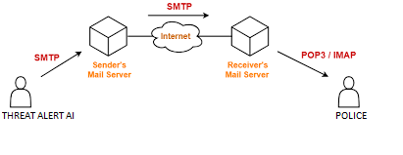
Approach
Final PHASE :
smtplib is Python's built-in module for sending emails to any Internet machine with an SMTP or ESMTP listener daemon.
Step 1: smptlib attaches the location link and audio file to email.
step 2: Finally, smptlib sends Threat Alert email to police .

Slide 13
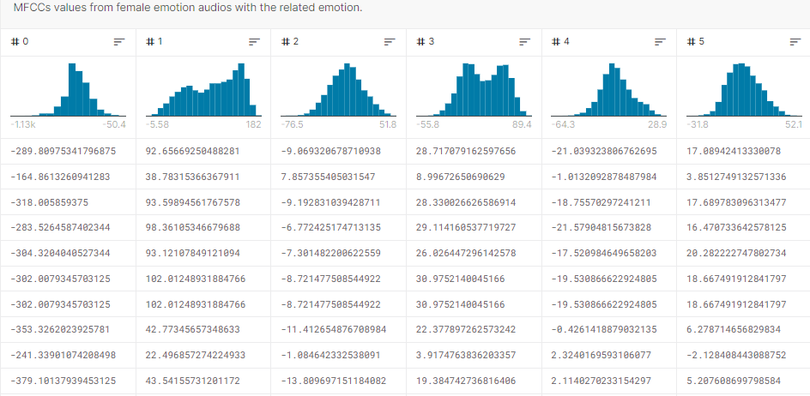
DATASETS

Slide 14
References
Monisha, D. G., M. Monisha, G. Pavithra, and R. Subhashini. "Women safety device and application-FEMME." Indian Journal of Science and Technology 9, no. 10 (2016): 1-6.
Khandelwal, Teena, Manisha Khandelwal, and Purnendu Shekhar Pandey. "Women safety device designed using IOT and machine learning." In 2018 IEEE SmartWorld, Ubiquitous Intelligence & Computing, Advanced & Trusted Computing, Scalable Computing & Communications, Cloud & Big Data Computing, Internet of People and Smart City Innovation (SmartWorld/SCALCOM/UIC/ATC/CBDCom/IOP/SCI), pp. 1204-1210. IEEE, 2018.
Pawar, R., M. Kulabkar, K. Pawar, A. Tambe, and P. Smita Khairnar. "Smart Shield for Women Safety." International Research Journal of Engineering and Technology (IRJET) e-ISSN 5, no. 4 (2018): 56-2395.

Slide 15
THANK YOU

